Slide 1
Communication Challenges Between Foreign Inmates and Norwegian Prison Officers
Richard Thripp
Oct. 10, 2013

Slide 2
Communication Problems and Language Barriers Between Foreign Inmates and Prison Officers VALENTINA C. IVERSEN St. Olav’s Hospital, Department of Psychiatry, Trondheim, Norway WENCHE L. MANGERUD The Regional Centre for Child and Adolescent Mental Health (RBUP) Mid-Norway, Department of Neuroscience, Faculty of Medicine, Norwegian University of Science and Technology (NTNU Norway), Trondheim, Norway TRINE TETLIE EIK-NES Levanger Hospital, Levanger, Norway ELLEN KJELSBERG Centre for Forensic Psychiatry, Psychiatric Division Ullevaal, Oslo University Hospital, Oslo, Norway

Slide 3
Introduction
Article was published March 12, 2013 online.
Appeared in the Journal of Immigrant & Refugee Studies
Citation: Valentina C. Iversen, Wenche L. Mangerud, Trine Tetlie Eik-Nes & Ellen Kjelsberg (2013) Communication Problems and Language Barriers Between Foreign Inmates and Prison Officers, Journal of Immigrant & Refugee Studies, 11:1, 65-77, DOI: 10.1080/15562948.2013.759042
Link: http://dx.doi.org/10.1080/15562948.2013.759042

Slide 4
Introduction
19 foreign inmates in a Norwegian prison
Study of their communication strategies toward prison officers
One-to-one, semi-structured interviews used

Slide 5
Demographics
7 African, 7 European, 5 Asian
18 males, 1 female
Mean age was 36
Mean sentence was about 6 years (71.7 months)
Sentences ranged from 8½ months to 17 years
9 were married before being incarcerated
10 were separated, divorced, or living alone
8 with no children
10 with one child or more
1 would not say if he or she had children
Notes:
Why so many males?

Slide 6
Demographics
15 in prison for use or sale of narcotics
2 in prison for murder
1 in prison for robbery
1 would not disclose
2 with college or university educations
1 high school graduate
9 with some secondary education
4 with some primary education
3 with no formal education
Notes:
Should so many people go to jail for drugs? Discuss correlation between less education, incarceration, and perhaps lower SES.

Slide 7
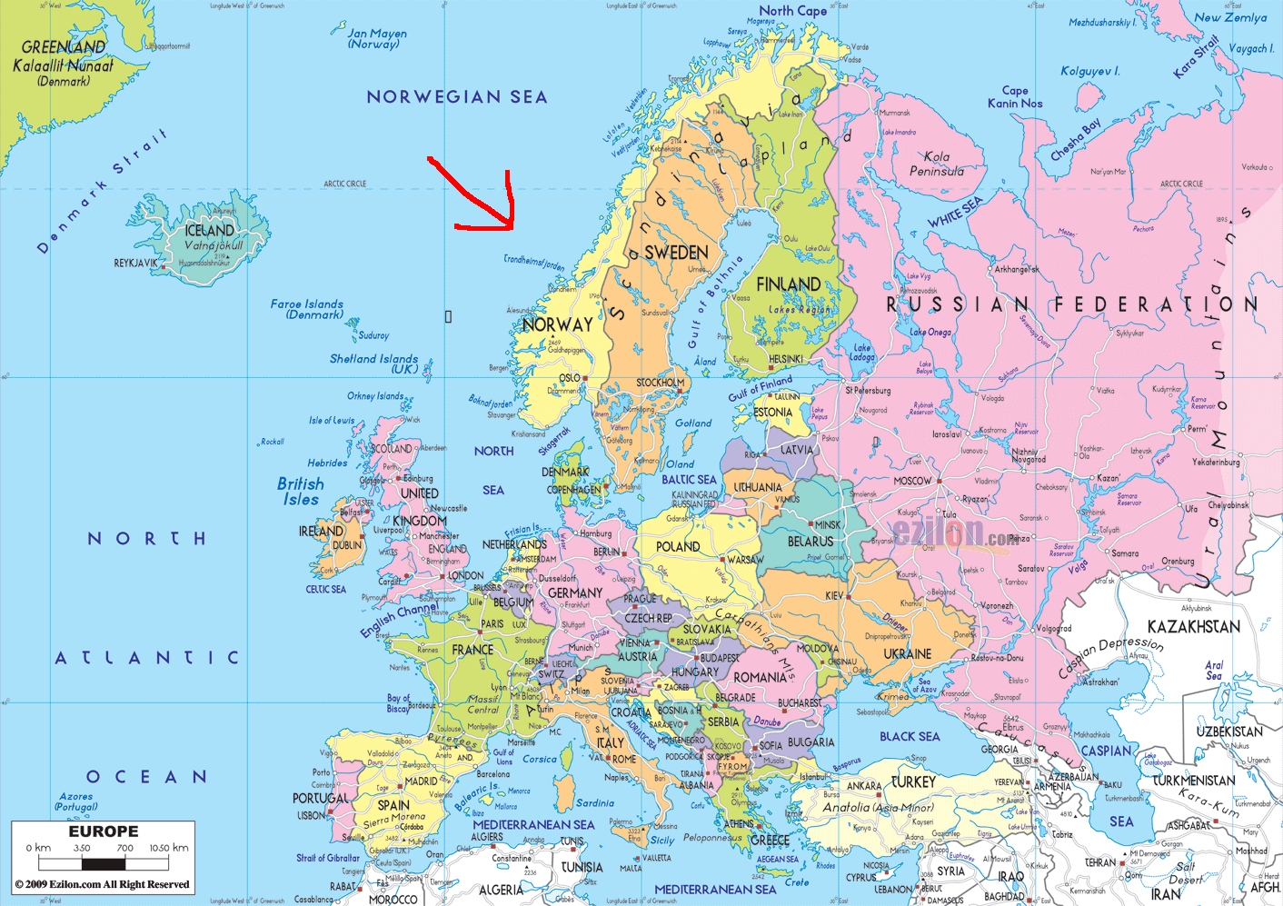

Slide 8
Methods
☆
Researchers chose qualitative study due to a lack of research reports in the field
They felt this gave them more individual insight
Data collected in November and December of 2009
Only prisoners from one prison were studied, which was selected from six prisons that participated in a quantitative survey
Prison officers were NOT interviewed—only foreign inmates

Slide 9
Methods
Study was approved by Norwegian Correctional Services
All informants were recruited through the prison administrators
The lead researcher visited the prison and interviewed all the inmates
Recruitment was on a voluntary basis

Slide 10
Methods
All 19 interviews were conducted by the 1st author, Valentina C. Iversen, and were each about 1 hour.
17 were taped and transcribed.
2 prisoners declined to be recorded on tape, expressing fear that prison staff might obtain the recordings, so notes were taken instead.

Slide 11
Methods
Participants were asked to verbally reconstruct one or more episodes involving aggression and communication problems
A set of questions was used, but the researcher modified the scheme based on each participant’s responses, to probe interesting and important areas
Participants were asked to discuss how everyday communication worked, especially in situations where prison officers were involved

Slide 12
Methods
☆
Data was analyzed using thematic analysis
Iversen and Mangerud separately coded the data, then compared their results and reached a consensus
All stages were checked by an outside researcher
Lists of keywords and notes were made from each transcript, and these were compared between participants for differences and similarities
Data analysis was then suspended for 2 weeks to allow for emotional distance and see if the researchers’ analyses changed
Finally, the text was condensed into 3 major themes

Slide 13
Many prisoners in the study felt there was nothing they could do to stay on the good side of the prison staff, so they chose silence and isolation instead.

Slide 14
Quotes from Inmates
The following 6 slides are actual quotes from the participants that were included in the “Outcomes” section of the article.
The quotes show what appears to be a systemic lack of communication between prison staff and foreign prisoners in this sample. Language barriers and lack of interpreters contribute to this divide, which may be compounded by racial and cultural discrimination.

Slide 15
Quotes from Inmates
“Here there are big problems, I mean discrimination of foreigners. There are no open doors for foreigners, they are like a second class people … and if inmates ask for help, I mean foreign inmates, it’s always a ‘no, we don’t have time, or no, it’s not like that,’ and that’s how they answer.” (Male, age 42) [p. 70]

Slide 16
Quotes from Inmates
“They spoke to me in Norwegian, I said ‘I don’t understand Norwegian,’ but they continued to speak Norwegian, even though I could not understand. A guy (a prison officer) once came to me and said: ‘Of course you speak Norwegian, but you don’t want to speak.’” (Male, age 35) [p. 71]

Slide 17
Quotes from Inmates
“It was really impossible to explain what I felt without having translators. They could not understand me. I waited months for a translator. I was irritated and angry. They didn’t believe me, as they thought that I was not seriously ill.” (Man, age 20) [p. 72]

Slide 18
Quotes from Inmates
☆
“During 4 years in prison, I have been two years in solitary confinement, and for no reason. They just took me out of the bed when I was asleep. It doesn’t matter if you’re born and raised in Norway … you’re considered to be a foreigner, and there’s always problems when one applies for a permission leave or a visit. A foreigner inmate is allowed to have a visitor once every eight weeks, while a Norwegian can have a visit two to three hours several days a week.” (Male, age 36) [p. 73]

Slide 19
Quotes from Inmates
“I don’t talk to them, because if I try to explain something to them, sometimes they don’t listen. Other things are more important than the language! I don’t really care about language. Maybe if I spoke Norwegian, I would have been more relaxed. I don’t think it is only about language. Isolation is the way to avoid frustration and fighting.” (Female, age 25) [p. 74]

Slide 20
Quotes from Inmates
“I speak Norwegian well. If a prison officer misunderstands what I say, they don’t give me the possibility to explain again before they write a report and send it to the leader. They don’t understand what I really want to say. These situations happen often, and I get aggressive and angry each time this happens. To avoid these situations, I prefer to stay on my own. (Male, age 25) [p. 74]

Slide 22
Results
The intention was to “explore how participants experienced their communication with prison staff.”
By analyzing the transcripts, 3 themes were identified:
Social and cultural differences
Emotional and psychological burdens
Withdrawing from others
Foreign inmates chose isolation instead of confrontation. They perceived prison officers as discriminatory and dismissive of their cultures.

Slide 23
Results
Immigrants in the study had interpreters only at meetings with the district Court Judge or Criminal Division, but never in day-to-day life
They communicated with gestures and body language, with almost no words
Body language often reflected anger and frustration
Many participants felt mentally ill, with some experiencing physical or psychological problems

Slide 24
Results
☆
Some communication problems were due to a lack of language skills
Others stemmed from a lack of interest in the prisoner’s point of view
Most participants attributed communication problems primarily to their background as immigrants, rather than absence of communication skills
They perceived discriminatory attitudes from prison officers as more of an impedance to communication than not speaking the same language!

Slide 25
Results
Immigrant inmates in the study felt humiliated, being subjected to severe prison regulations and staff who do not care about their well-being.
Making inferences, understanding metaphors, and deciphering ambiguity are quite difficult for migrants who did not grow up learning the language.
Participants seemed to live in constant stress, fearing being misunderstood.

Slide 26
Results
The inmates had emotional and psychological burdens relating to their status as foreign prisoners and felt out-of-control, especially when being placed in solitary confinement or otherwise punished without reason.
Many chose withdrawal and isolation, refusing to interact with prison officers and sometimes fellow prisoners.
Prisoners who have been cut off from family, friends, and their social network by being transferred from distant prisons are more likely to isolate themselves and suffer from declining mental health.

Slide 27
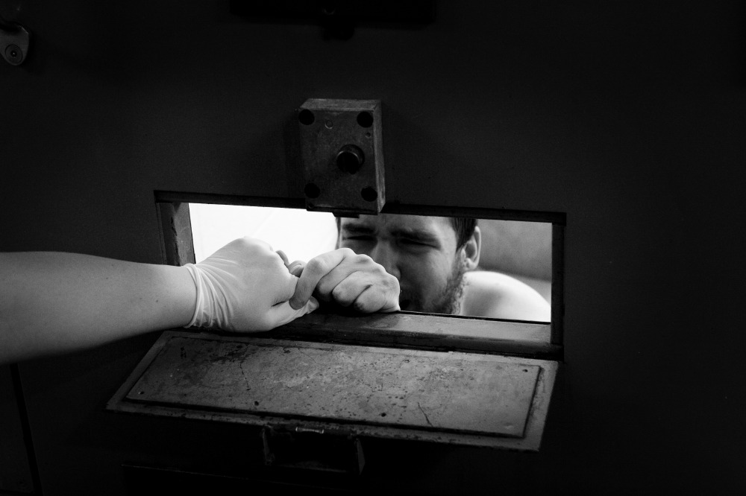

Slide 28
Implications
Isolation and withdrawal are not acceptable solutions. They are psychologically detrimental, leading to anger, depression, lost of self-control, and self-destruction.
Verbal and nonverbal communication between foreign prisoners and officers should be strengthened, perhaps through training programs and hiring prison staff who speak common foreign languages, such as Spanish in the United States.
More interpreters are needed. Foreign prisoners should not be afforded interpretation only at criminal proceedings!

Slide 29
Implications
Prison officers are at risk for being discriminatory, since they have the power to control the situation. If they dislike an inmate, communication becomes difficult.
Most prison systems have a stated goal of rehabilitating their inmates. Effective communication is essential to this goal. Solitary confinement can be torturous and should be reserved as a punishment of last resort.
Since the maximum prison sentence is 21 years in Norway, most inmates will survive to be released. Treating them humanely may reduce recidivism.

Slide 30
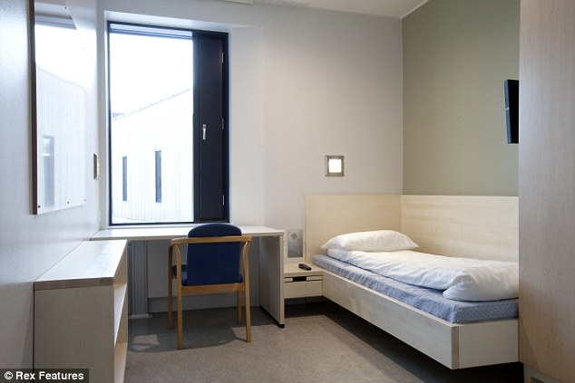
Implications
Halden Prison is an experimental ecological prison on Bastøy Island, Norway offering unprecedented amenities. It was built over 10 years at a cost of £15 million and houses 252 prisoners including rapists and murderers.

Slide 31
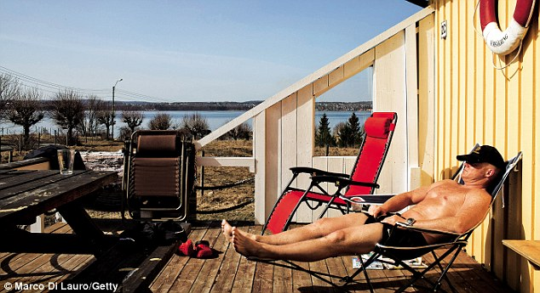
Implications
What if some of this money went to employ interpreters for nonviolent offenders such as the 15 inmates convicted of drug crimes in this study? Would that be a more worthwhile cause?

Slide 32
Implications
☆
Several participants said they react aggressively due to a “culture crash” rather than language problems. Perhaps prison staff should receive sensitivity training to help them understand what their prisoners are feeling?
The treatment of prisoners may be a reflection of public opinion. If the people believe prisoners are sub-human criminals who do not even deserve 3 meals per day, how will this be reflected in the behavior of prison guards?
Even native citizens can be discriminated against if they are not part of the majority group. What implications does this have for minorities in American prisons?

